Slide 1
Corporate & Social
Responsibility
(CSR) Policy

Slide 2





Introduction
Introduction
The CatSci Group Corporate and Social Responsibility (CSR) Policy outlines our commitment to conducting business in a socially and responsible manner
COMMUNITY
SDG’S
  At CatSci, we are committed to operating a socially responsible company. We believe that corporate social responsibility represents a long-term investment that strengthens our operations and competitiveness in the marketplace. As a responsible corporate citizen, it is our duty to contribute to the well-being of the communities in which we operate and minimise our environmental footprint.
  This Policy reflects our dedication to:
  Employee well-being – We value our employees and are committed to providing a safe, healthy and inclusive work environment where everyone is treated with dignity and respect.
  Environmental sustainability – We are dedicated to minimising our environmental impact by implementing sustainable practices, reducing waste and conserving resources.
  Sustainable supply chains – We are committed to ensuring that our supply chains operate ethically, responsibly and sustainably.
  Ethical business practices – We are committed to upholding the highest standards of integrity, honesty and fairness in all our operations.
  Community engagement – We strive to make meaningful contributions to the communities in which we operate.
  Transparency and accountability - We are committed to transparency and will regularly report on our CSR initiatives, progress and challenges.
  The pillars of our CSR Policy have been set out here
People
GOVERNANCE
Environment
SUPPLY CHAIN
Supply Chain
Governance
ENVIRONMENT
Community
Approval
PEOPLE

Slide 3









The United Nations Sustainable Development Goals
Introduction
We seek to align our CSR strategy with the United Nations Sustainable Development Goals (SDGs). We have identified 8 SDGs that best align to our business activities and/or social impact.
SDG’S
People
Through the work we do for our customers we deliver life changing medicines that improve the health and wellbeing of patients. Wellbeing is also a key focus for our team.
Through our initiatives to move to renewable energy sources and reduce energy consumption.
Through our compliance with waste management regulations and our practices for chemical waste disposal, we aim to be sustainable in our production and consumption patterns.
Environment
Supply Chain
Through our initiatives and relationships with school and our learning and development programmes, we aim to promote lifelong learning opportunities for all.
Through our culture, rewards and benefits we seek to provide a great place to work, developing the careers of all employees and contributing to economic development.
Through our initiatives promoting composting, recycling and the implementation of our cycle to work schemes, we aim to combat climate change and its impacts.
Governance
Community
Through our initiatives and benefits we seek to improve gender equality in our business.
Through our hiring practices and policies, we aim to reduce inequalities within our team and promote equal access to benefits and quality employment.
Approval

Slide 4
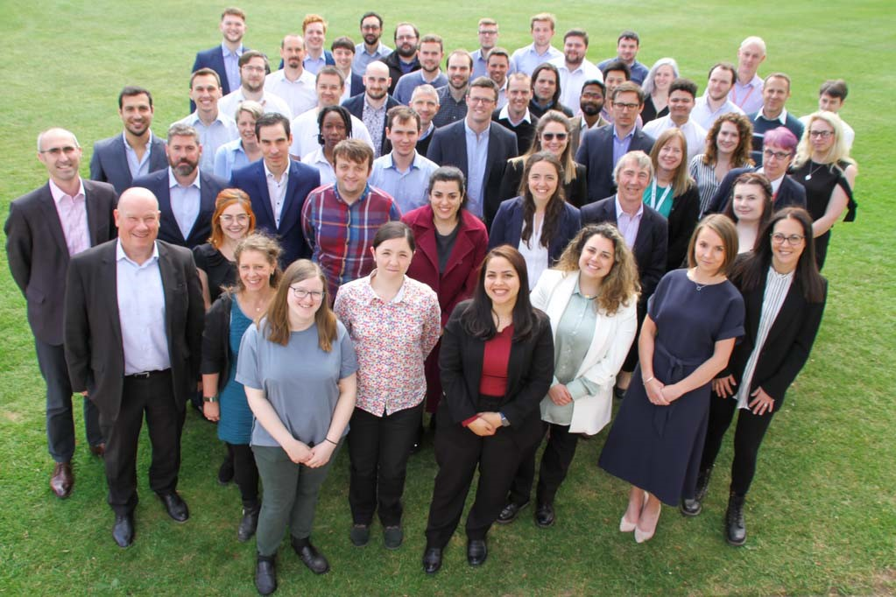
People
Introduction
Our team is essential to our success. If our employees are happy, motivated and healthy we can better serve our customers and ultimately our mission of helping patients in need.
SDG’S
People
  We believe that our employees are our most valuable asset. We are committed to creating a safe, inclusive and supportive work environment where all employees are valued, respected and empowered to reach their full potential.
  We commit to:
  Respect diversity and promote equal opportunities by creating an inclusive work environment where all employees feel valued, respected and empowered to contribute their unique perspectives and talents. This includes removing any barriers to achieving gender parity across all levels in the organisation.
  Provide a safe and healthy work environment, free from hazards and risk and to ensure that all employees receive the necessary training and resources to perform their jobs safely.
  Provide a fair and competitive compensation and benefits package that recognises the contributions of our employees and helps them achieve financial security and stability.
  Supporting the professional growth and development of our employees through training, mentorship and career advancement opportunities.
Environment
Supply Chain
Governance
Community
Approval

Slide 5

Environment
Introduction
We are committed to minimising our environmental footprint and promoting sustainability in every aspect of our operations.
SDG’S
  We recognise the profound impact that our business operations can have on the environment. As a responsible corporate citizen, we are committed to minimising our environmental footprint and promoting sustainability in every aspect of our operations.
  We commit to:
  Reducing our greenhouse gas emissions and working towards achieving carbon neutrality by 2045. We will achieve this by implementing energy efficient processes, increasing our use of renewable energy and offsetting any remaining emissions through responsible carbon offset projects.
  Reduce our Scope 1 and Scope 2 carbon emissions by 42% by 2030 inline with our SBTi baseline.
  Conserving natural resources, including water, energy and raw materials, by implementing measures to reduce consumption, minimise waste and increase efficiency throughout our operations.
  Reducing waste generation and promoting recycling initiatives to minimise the amount of waste send to landfills.
  Comply with applicable legal and other requirements to which the Company subscribes which relate to environment and other aspects that affect the planet.
People
Environment
Supply Chain
Governance
Community
Approval

Slide 6

Supply Chain
Introduction
We are committed to ensuring our supply chain operates ethically, responsibly and sustainably.
SDG’S
  We recognise the critical role that our supply chain plays in our overall sustainability efforts. As a responsible corporate citizen, we are committed to ensuring that our supply chain operates ethically, responsibly and sustainably. Our sustainable supply chain policy reflects our dedication to minimising environmental impact, promoting social responsibility and upholding ethical standards throughout the supply chain.
  We commit to:
  Ensure all key suppliers are aligned to our vision of CSR and sign up to our supplier Code of Conduct or are able to provide evidence of compliance with the key provisions and spirit of good practice within the Code of Conduct.
  Prioritise suppliers who share our commitment to environment sustainability, including the reduction of greenhouse gas emissions, energy efficiency, waste reduction and responsible water management.
  Continuously assess and improve our supply chain practices, working collaboratively with our suppliers to identify opportunities for innovation, efficiency and sustainability.
People
Environment
Supply Chain
Governance
Community
Approval

Slide 7

Governance
Introduction
We recognise that building a strong corporate governance structure and practices are key in driving growth, enhancing stability and fostering integrity, accountability and transparency.
SDG’S
People
  We understand the importance of ensuring strong governance practices in ensuring transparency, accountability and ethical behaviour in all aspects of our business operations.
  We commit to:
  Conducting our business with honesty, integrity and transparency, adhering to the highest ethical standards in all our operations.
  Maintain an independent and diverse Board of Directors, composed of individuals with a wide range of backgrounds, skills and expertise, to provide effective oversight and guidance.
  Implement all control mechanism and tools for due application of the Policy at all corporate levels, and in every market.
  Maintain robust risk management processes to identify, assess and mitigate risks to our business including financial, environmental, social and governance related risks.
  Upholding and promoting human rights in all aspects of our operations and every community in which we operate. We pledge to conduct our business in accordance with the international human rights standards including the Universal Declaration of Human rights and the United Nations Guiding principles on Business and Human Rights.
Environment
Supply Chain
Governance
Community
Approval

Slide 8

Community
Introduction
We seek to actively contribute to the betterment of our communities.
SDG’S
  We are committed to making a positive difference in the communities in which we operate by actively engaging with them, supporting local initiatives and contributing to their social and economic development.
  We commit to:
  Support local organisations, charities and community initiatives that address key social and environmental issues and contribute to the well-being of the communities in which we operate.
  Encourage and support our employees to volunteer their time and skills to support community projects and initiatives that are important to them.
  Continue to be an ambassador for young and future scientists.
  Build strong, long-term partnerships with local organisations, governments and community leaders to address shared challenges.
People
Environment
Supply Chain
Governance
Community
Approval

Slide 9

Approval Of The Policy/ Reporting
Introduction
The approval of the Policy lies with the Board of Directors of the Group
Date Formulated | April 2025
Date approved | 30th April 2025
Version No. | 2.0
Description of changes | Page 4 – The following paragraph has been added to specify a specific policy goal. This includes removing any barriers to achieving gender parity across all levels in the organisation. Page 5 – The following commitment has been added “Reduce our Scope 1 and Scope 2 carbon emissions by 42% by 2030 inline with our SBTi baseline.”
Approved by CEO
SDG’S
  The approval of the CSR Policy is the responsibility of the CatSci Group Board of Directors.
  In order to facilitate the tasks concerning control, supervision and monitoring of the internal implementation of this Policy, the Chief Financial Officer will be responsible alongside the ESG committee for supervising the co-ordination of all activities relating to sustainability and, specifically for proposing the strategies and corporate plans, establishing management and control measures and reviewing sustainability measures and initiatives.
  The ESG committee will look to report to the Board monthly with relevant KPIs and actions taken with a summary of progress and actions included in the Annual report. The Annual report will be made available to all stakeholders on the CatSci Group website. We commit to align our reporting to internationally recognised standards.
  The Policy will be reviewed at least once a year. The main purpose of the review process is to adapt the Policy for new developments affecting the Company and its stakeholders so that it remains a good compass for the Company’s strategy in response to its stakeholders’ demands. Any changes in the Policy will be approved at Board level.
People
Environment
Supply Chain
Governance
Community
Approval

